Slide 1
Building Java Programs
Chapter 10
Lecture 10-1: ArrayList
reading: 10.1

Slide 2
Welcome to CSE 143!
I'm Hélène Martin
http://cs.washington.edu/143

Slide 3
CSE 143
Goal: learn tools for automating complex tasks efficiently
  Abstraction (client vs. implementation)
  Data structures
  Algorithms
Prerequisite: can automate basic tasks using a programming language (logic, control flow, decomposition)
For EVERYONE, not just CSE majors
Learn by doing
Lots of support (undergraduate TAs, IPL, message board)

Slide 4
Programming
CS: "efficiently implementing automated abstractions" ¹
Building things is empowering
  Small number of fundamentals can solve lots of problems
  When a program works, it's obvious
  Welding, chain saws, safety glasses not required
A LOT of complexity to master: exciting and scary
Java is our tool in 14x but lessons transfer broadly
1 http://www.pgbovine.net/what-is-computer-science.htm

Slide 5
Being Successful
Determination, hard work, focus
Investing time (~15 hours a week)
  Starting early
  Developing problem-solving strategies
  Developing a consistent style
Knowing when to ask for help
  Go to the IPL
  Talk to me after class, during office hours
Studying together
  Homework is individual but studying in groups pays off

Slide 6
Logistics
Get to know http://cs.washington.edu/143
2 sections a week
  Turn in ONE set of problems each week for credit
Grading described on syllabus
  45% projects, 20% midterm, 35% final
Weekly programming projects
  Academic honesty is serious
  40 point scale
  5 "free late days"; -2 for subsequent days late

Slide 7
Words exercise
Write code to read a file and display its words in reverse order.
A solution that uses an array:
  String[] allWords = new String[1000];
  int wordCount = 0;
  Scanner input = new Scanner(new File("words.txt"));
  while (input.hasNext()) {
  String word = input.next();
  allWords[wordCount] = word;
  wordCount++;
  }
What's wrong with this?

Slide 8
Recall: Arrays (7.1)
array: object that stores many values of the same type.
  element: One value in an array.
  index: 0-based integer to access an element from an array.
  length: Number of elements in the array.
index | 0 | 1 | 2 | 3 | 4 | 5 | 6 | 7 | 8 | 9
value | 12 | 49 | -2 | 26 | 5 | 17 | -6 | 84 | 72 | 3
element 0
element 4
element 9
length = 10

Slide 9
Array Limitations
Fixed-size
Adding or removing from middle is hard
Not much built-in functionality (need Arrays class)

Slide 10
List Abstraction
Like an array that resizes to fit its contents.
When a list is created, it is initially empty.
  []
Use add methods to add to different locations in list
  [hello, ABC, goodbye, okay]
  The list object keeps track of the element values that have been added to it, their order, indexes, and its total size.
  You can add, remove, get, set, ... any index at any time.

Slide 11
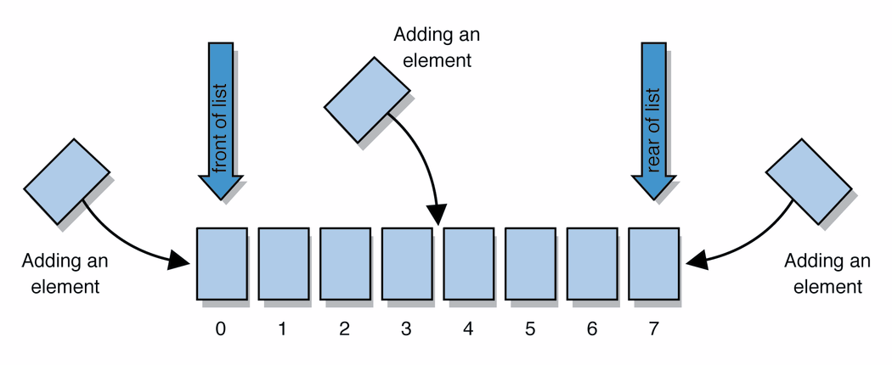
Collections and lists
collection: an object that stores data ("elements")
    import java.util.*; // to use Java's collections
list: a collection of elements with 0-based indexes
  elements can be added to the front, back, or elsewhere
  a list has a size (number of elements that have been added)
  in Java, a list can be represented as an ArrayList object

Slide 12
Type parameters (generics)
ArrayList<Type> name = new ArrayList<Type>();
When constructing an ArrayList, you must specify the
type of its elements in < >
  This is called a type parameter ; ArrayList is a generic class.
  Allows the ArrayList class to store lists of different types.
  Arrays use a similar idea with Type[]
  ArrayList<String> names = new ArrayList<String>();
  names.add("Marty Stepp");
  names.add("Stuart Reges");

Slide 13
ArrayList methods (10.1)*
add(value) | appends value at end of list
add(index, value) | inserts given value just before the given index, shifting subsequent values to the right
clear() | removes all elements of the list
indexOf(value) | returns first index where given value is found in list (-1 if not found)
get(index) | returns the value at given index
remove(index) | removes/returns value at given index, shifting subsequent values to the left
set(index, value) | replaces value at given index with given value
size() | returns the number of elements in list
toString() | returns a string representation of the list such as "[3, 42, -7, 15]"
* (a partial list; see 10.1 for other methods)

Slide 14
ArrayList vs. array
  String[] names = new String[5]; // construct
  names[0] = "Jessica"; // store
  String s = names[0]; // retrieve
  for (int i = 0; i < names.length; i++) {
  if (names[i].startsWith("B")) { ... }
  } // iterate
  ArrayList<String> list = new ArrayList<String>();
  list.add("Jessica"); // store
  String s = list.get(0); // retrieve
  for (int i = 0; i < list.size(); i++) {
  if (list.get(i).startsWith("B")) { ... }
  } // iterate

Slide 15
ArrayList as param/return
public static void name(ArrayList<Type> name) {// param
public static ArrayList<Type> name(params) // return
Example:
  // Returns count of plural words in the given list.
  public static int countPlural(ArrayList<String> list) {
  int count = 0;
  for (int i = 0; i < list.size(); i++) {
  String str = list.get(i);
  if (str.endsWith("s")) {
  count++;
  }
  }
  return count;
  }

Slide 16
Words exercise, revisited
Write a program that reads a file and
displays the words of that file as a list.
  Then display the words in reverse order.
  Then display them with all plurals (ending in "s") capitalized.
  Then display them with all plural words removed.

Slide 17
Exercise solution (partial)
ArrayList<String> allWords = new ArrayList<String>();
Scanner input = new Scanner(new File("words.txt"));
while (input.hasNext()) {
String word = input.next();
allWords.add(word);
}
// display in reverse order
for (int i = allWords.size() - 1; i >= 0; i--) {
System.out.println(allWords.get(i));
}
// remove all plural words
for (int i = 0; i < allWords.size(); i++) {
String word = allWords.get(i);
if (word.endsWith("s")) {
allWords.remove(i);
i--;
}
}

